Slide 1



Presenting the MHCV Construck module on Signa 2823.K RMC
This eLearning course gives an Introduction to Signa 2823.K RMC sales talk points with Power of 6 , Technical Specs & Advantages
There are animated screens, hotspots for interactivity, drag & drop features and assessments to keep you engaged
Product Presentation
Signa 2823.K RMC
10 minutes

Slide 2

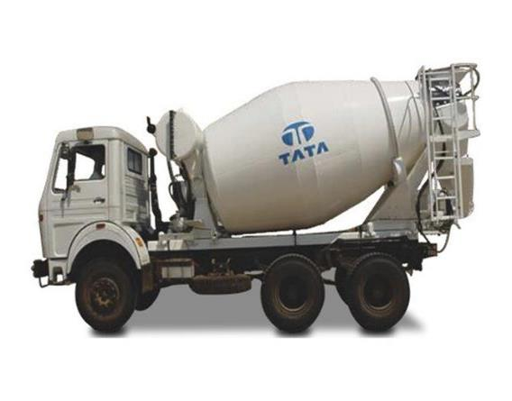
Signa 2823.K RMC

Slide 3








Tata Motors MHCV – Power of 6
Signa 2823.K RMC
Use the same icons and names as used in slide #15 (hidden) / website
POWER OF ENHANCED PERFORMANCE
POWER OF LOWER TOTAL COST OF OWNERSHIP
POWER OF COMFORT & CONVENIENCE
This is just a representation. You can use some other prop
POWER OF CHOICE
POWER OF CONNECTIVITY
TOTAL PEACE OF MIND
There should be a distinctive area between these Power of part and the remaining part in slides

Slide 4
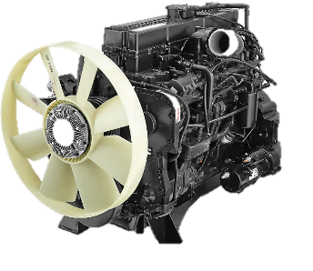
Signa 2823.K RMC
1. Performance that Matters!
Signa 2823.K RMC BS6
Tata Cummins 5.6L
164kW @ 2300 rpm
850 Nm @ 1000 -1600 rpm
Tata Cummins 6.7L
186kW @ 2300 rpm
950 Nm @ 1100 -1700 rpm
POWER OF ENHANCED PERFORMANCE
POWER OF LOWER TOTAL COST OF OWNERSHIP
Advantages
Benefits
POWER OF COMFORT & CONVENIENCE
Derived from worlds highest selling engine
22% more power at lower rpm
22% more Torque than BS4 at same RPM
Now get 3% more trips resulting in 11% higher revenue
POWER OF CHOICE
POWER OF CONNECTIVITY
“Higher pulling power resulting in higher Productivity “
TOTAL PEACE OF MIND

Slide 5

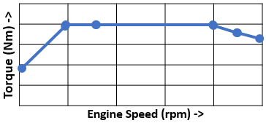

Signa 2823.K RMC
2. Easy on the Pocket – Less operating Expenses
Signa 2823.K RMC
4 Cylinder- 5L engine
3 Mode Fuel Economy Switch
1000 rpm range-100% flatter than bs4
2 Mode Fuel Economy Switch
22% higher torque
POWER OF ENHANCED PERFORMANCE
3 Mode Fuel Economy Switch
600 rpm range – Flat Torque Curve
POWER OF LOWER TOTAL COST OF OWNERSHIP
1. Higher Fuel Economy
POWER OF COMFORT & CONVENIENCE
Advantages
Benefits
POWER OF CHOICE
3 modes - Light, Medium, Heavy - based on Duty cycle
Higher Fuel Mileage
Higher fuel savings with usage of fuel economy switch
POWER OF CONNECTIVITY
Higher pulling ability
Better pick up at low rpm
Higher FUEL EFFICIENCY
Less need to shift to lower gear
Less gear changes, resulting in higher fuel economy
TOTAL PEACE OF MIND

Slide 6




Signa 2823.K RMC
2. Easy on the Pocket – Less operating Expenses
Signa 2823.K RMC
POWER OF ENHANCED PERFORMANCE
Truck Hub Unit (Optional)
Truck Hub Unit (Optional)
Straight frame
Engine Brake
ICGT Brakes
Front sus 90mm Leaf Width
POWER OF LOWER TOTAL COST OF OWNERSHIP
2. Lower Maintenance Cost
POWER OF COMFORT & CONVENIENCE
Advantages
Benefits
THU - No Lubrication
5500 hrs life (~ Rs 45K* saving/year)
No hub greasing required for 5500hrs/ 5L Kms
Saving in maintenance cost
Higher running uptime
POWER OF CHOICE
POWER OF CONNECTIVITY
ICGT - 40% Better life
29% more leaf width- more life
Enhanced brake life
Low chance of tyre burst due to heating
Less Maintenance costs
TOTAL PEACE OF MIND
Longer Suspension & Frame life
Supports tyre life
When the life of the parts is more. Less hassle and more savings
* Conditions Apply

Slide 7


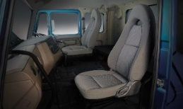

Signa 2823.K RMC
3. More comfort, convenience & safety – Higher Productivity
Signa 2823.K RMC
Tilt & Telescopic steering
USB Charger
POWER OF ENHANCED PERFORMANCE
New Advanced Instrument cluster
Comfortable Cabin,
Washable Trims
POWER OF LOWER TOTAL COST OF OWNERSHIP
1. Comfort & Convenience
POWER OF COMFORT & CONVENIENCE
Advantages
Benefits
POWER OF CHOICE
Comfortable steering position as per driver need
Less Driver Fatigue
More number of trips.
Ease of driving for enhanced driving comfort
POWER OF CONNECTIVITY
Wide, Spacious & comfortable cabin
Retained newness – Trims can be removed & cleaned
Now the cabin is more comfortable
TOTAL PEACE OF MIND
2 High Speed USB chargers
Driver Delight!
Enhanced driver convenience with high speed USB chargers

Slide 8



Signa 2823.K RMC
3. More comfort, convenience & safety – Higher Productivity
Signa 2823.K RMC
POWER OF ENHANCED PERFORMANCE
HDPE Fuel Tank
LED Tail lamp
Vertical Exhaust
POWER OF LOWER TOTAL COST OF OWNERSHIP
2. Enhanced Safety
POWER OF COMFORT & CONVENIENCE
Advantages
Benefits
Impact resistant
Leak proof , rust proof
More Strength Hence More Saftey
POWER OF CHOICE
POWER OF CONNECTIVITY
New Gen LED Taillamp
Lower Power consumption
High visibility during day and Night
Lower Power consumption with enhanced visibility
TOTAL PEACE OF MIND
Dust free working conditions
Higher ground clearance
Damage free exhaust system
Dust free working environment Better life for exhaust components

Slide 9
Signa 2823.K RMC
4. More Choice to select Value Feature Options
Signa 2823.K RMC
Choose CX, LX value feature
Powerful AC
Truck Hub Unit (THU) Lubricated for LIFE
BS6
6, 7, 8 & 9 CuM Option
POWER OF ENHANCED PERFORMANCE
POWER OF LOWER TOTAL COST OF OWNERSHIP
Advantages
Benefits
POWER OF COMFORT & CONVENIENCE
Higher productivity
Higher revenue
Longer tyre life
Lesser maintenance
POWER OF CHOICE
“Choose LX, get more productivity and lower expenses!”
POWER OF CONNECTIVITY
TOTAL PEACE OF MIND
4 RMC sizes for different densities or volume & weight of goods

Slide 10


Signa 2823.K RMC
5. Stay Connected with your Fleet – Increase Productivity
Signa 2823.K RMC
POWER OF ENHANCED PERFORMANCE
New Gen Telematics
Electronic Anti Fuel Theft
POWER OF LOWER TOTAL COST OF OWNERSHIP
Advantages
Benefits
POWER OF COMFORT & CONVENIENCE
Real Time Vehicle Tracking
Geo Fencing
Fuel Consumption Monitoring
Engine Idle Monitoring
Harsh Braking Monitoring
Free Activation*
6 years Free Subscription
Enhanced Fleet Management
POWER OF CHOICE
POWER OF CONNECTIVITY
Electronic AFT fitted on the Fuel tank
Instant SMS notification of theft through Telematics
Greater Control over fuel pilferage
Instant fuel theft notification – resulting in higher savings
TOTAL PEACE OF MIND

Slide 11
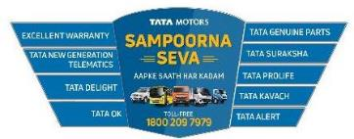




Signa 2823.K RMC
6. Sampoorna Seva – Aapke Saath Har Kadam
Widest Service Network
POWER OF ENHANCED PERFORMANCE
1600+ Service points
50,000+
trained Mechanics
POWER OF LOWER TOTAL COST OF OWNERSHIP
POWER OF COMFORT & CONVENIENCE
Service @ Site ONSITE
Best in Industry –SERVICE RESPONSE reach time
6Y/6K*
Driveline Warranty
POWER OF CHOICE
Tata Genuine Parts
in every location
6 am-10 pm : < 2 Hrs* reach time
10 pm-6 am : < 4 Hrs* reach time
Service resolution assurance < 24 Hrs*
POWER OF CONNECTIVITY
Best in class RESALE Value*
Trust of TATA
TOTAL PEACE OF MIND
Customised FMS & AMC with Onsite Service
*TC apply

Slide 12



Assured Accidental
repairs within 15 days*
TATA Kavach
Assured Accidental
repairs within 15 days*
6Y/6K*
Driveline Warranty
Tata Samarth for DRIVER family's financial, educational, accident
and health insurance needs.
Surakshit SAMARTH
Sampatti SAMARTH
Swastha SAMARTH
Shiksha SAMARTH

Slide 13
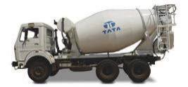
Signa 2823.K RMC
Signa 2823.K RMC - Technical Specifications
MODEL | Signa 2823.K 6/7/8 m3 RMC | Signa 2823.K 9 m3 RMC TM
ENGINE | Cummins ISBe 5.6 l BS6 | Cummins ISBe 5.6 l BS6
Max Power | 164 kW @ 2300 rpm | 164 kW @ 2300 rpm
Max Torque | 850 Nm @ 1000- 1600 rpm | 850 Nm @ 1000- 1600 rpm
CLUTCH | 380 mm single Plate Dry friction Organic Lining | 380 mm single Plate Dry friction Organic Lining
TRANSMISSION | G950 6 speed Gearbox | G1150 9 Speed Gearbox
FRONT AXLE | Heavy Duty Forged I beam Reverse Elliot Type | Heavy Duty Forged I beam Reverse Elliot Type
REAR AXLE | Single Reduction, Heavy Duty rear axle with differential lock | Single Reduction, Heavy Duty rear axle with differential lock
SUSPENSION | Front : Option I : Semi Elliptical Leaf Spring Option II : Parabolic leaf spring Rear : Option 1 : Semi Elliptical Leaf Spring Option 2 : TML Bogie suspension | Front : Semi elliptical leaf spring Rear : TML bogie suspension
FRAME | Heavy Duty straight frame with riveted/ bolted cross members | Heavy Duty straight frame with riveted/ bolted cross members
CAB | Signa Non Sleeper Cabin | Signa Non Sleeper Cabin
TYRES | 295/95 D20 Nylon tyres | 295/95 D20 Nylon tyres
VENTILATION | Blower/ Air Conditioning (Optional) | Blower/ Air Conditioning (Optional)
SERVICE BRAKE | New iCGT Brakes | New iCGT Brakes
FUEL TANK | 300 Ltr HDPE Tank | 300 Ltr HDPE Tank
WHEELBASE options | 3880 mm (6 m³, 7 m³) | 4880 mm(8 m³) | 5580 mm
GROSS VEHICLE WEIGHT | 28000 kg | 28000 kg
Body options | 6 m³ | 7 m³ | 8 m³ RMC Transit Mixer | 9 m³ RMC Transit Mixer

Slide 14
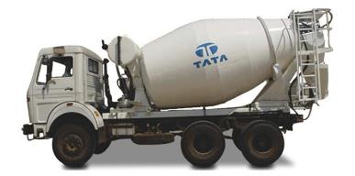
Signa 2823.K RMC
Knowledge Check – brief online Test
Question #1
Use your normal format of knowledge check

